Slide 1
Local & Inter Networks
how are we all wired together?

Slide 2
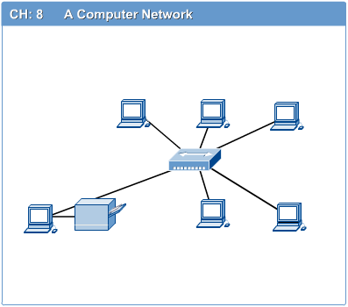
Computer Networks
Introduction to Computer Networks
Computer network connects two or more autonomous computers.
The computers can be geographically located anywhere.

Slide 3
LAN, MAN & WAN
Introduction to Computer Networks
Network in small geographical Area (Room, Building or a Campus) is called LAN (Local Area Network)
Network in a City is call MAN (Metropolitan Area Network)
Network spread geographically (Country or across Globe) is called WAN (Wide Area Network)

Slide 4
Applications of Networks
Introduction to Computer Networks
Resource Sharing
Hardware (computing resources, disks, printers)
Software (application software)
Information Sharing
Easy accessibility from anywhere (files, databases)
Search Capability (WWW)
Communication
Email
Message broadcast
Remote computing
Distributed processing (GRID Computing)

Slide 5
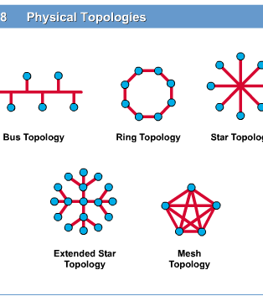
Network Topology
Introduction to Computer Networks
The network topology defines the way in which computers, printers, and other devices are connected. A network topology describes the layout of the wire and devices as well as the paths used by data transmissions.

Slide 6
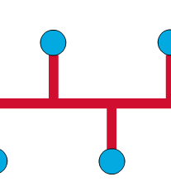
Bus Topology
Introduction to Computer Networks
Commonly referred to as a linear bus, all the devices on a bus topology are connected by one single cable.

Slide 7
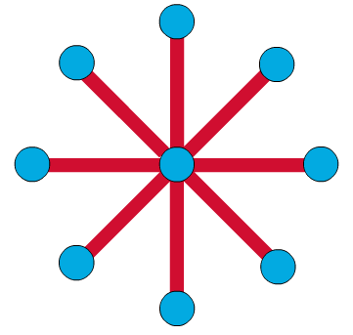
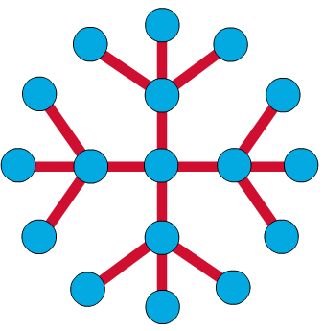
Star & Tree Topology
Introduction to Computer Networks
The star topology is the most commonly used architecture in Ethernet LANs.
When installed, the star topology resembles spokes in a bicycle wheel.
Larger networks use the extended star topology also called tree topology. When used with network devices that filter frames or packets, like bridges, switches, and routers, this topology significantly reduces the traffic on the wires by sending packets only to the wires of the destination host.

Slide 8
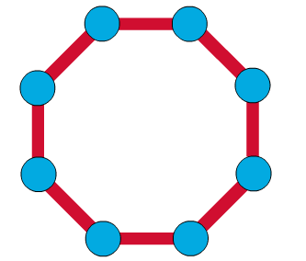
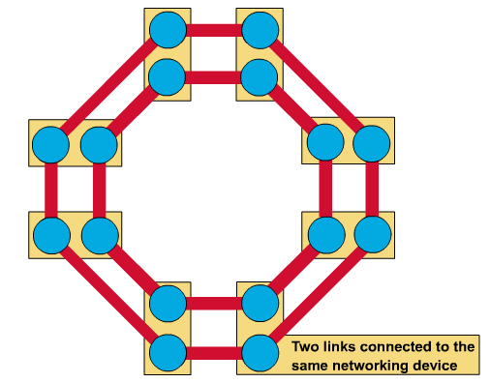
Ring Topology
Introduction to Computer Networks
A frame travels around the ring, stopping at each node. If a node wants to transmit data, it adds the data as well as the destination address to the frame.
The frame then continues around the ring until it finds the destination node, which takes the data out of the frame.
Single ring – All the devices on the network share a single cable
Dual ring – The dual ring topology allows data to be sent in both directions.

Slide 9
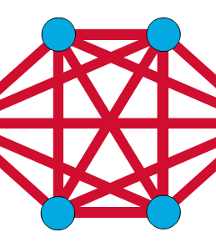
Mesh Topology
Introduction to Computer Networks
The mesh topology connects all devices (nodes) to each other for redundancy and fault tolerance.
It is used in WANs to interconnect LANs and for mission critical networks like those used by banks and financial institutions.
Implementing the mesh topology is expensive and difficult.

Slide 10
Network Components
Introduction to Computer Networks
Physical Media
Interconnecting Devices
Computers
Networking Software
Applications

Slide 11
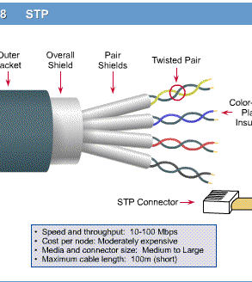
Networking Media
Introduction to Computer Networks
Networking media can be defined simply as the means by which signals (data) are sent from one computer to another (either by cable or wireless means).

Slide 12
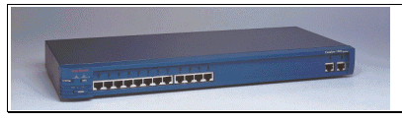
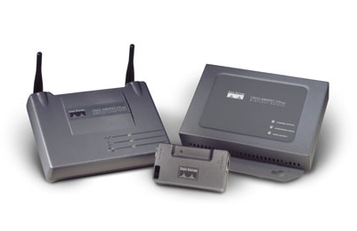
Networking Devices
Introduction to Computer Networks
HUB, Switches, Routers, Wireless Access Points, Modems etc.

Slide 13
How do networks work?
Software
an application asks for or receives data
software
hardware
Networks
wires
switches
ethernet
another software “packetizes” the data and addresses the “envelope” to send to...

Slide 14
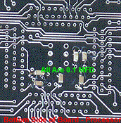
How do networks work?
Hardware
software
hardware
Networks
wires
switches
ethernet
the network computer receives these packets and pushes them out the door over...

Slide 15
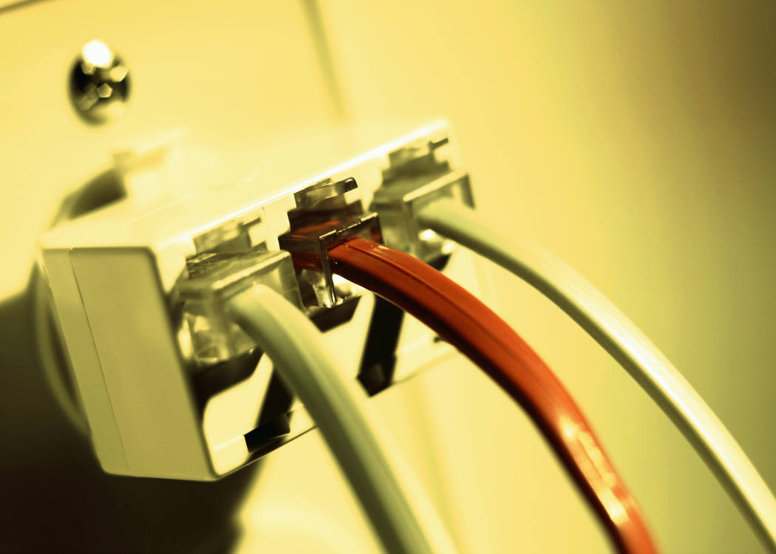
How do networks work?
Wires & Electronics
software
hardware
Networks
wires
switches
ethernet
the cable connecting the computer to the network electronics
which forwards the packets to other electronics until they get to their destination

Slide 16
Switches
Sw1
1.A
1.B
1.C
1.D
1.E
System 1.A seeking System 2.B
Switches work by keeping track of the systems located off their ports
software
hardware
Networks
wires
switches
ethernet
Sw2
2.A
2.B
2.C
if the system that is sought is not connected to that switch, the switch will send the request to other switches until it is able to find the switch that contains the sought system.

Slide 17
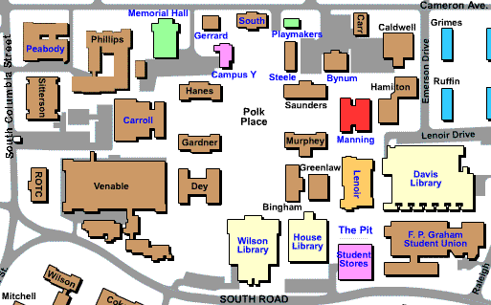
Internal Switches
So, in Manning,
we have several switches,
several servers,
and several networks
software
hardware
Networks
wires
switches
ethernet
Our switches and "main" servers for the building plug into the main switch for Manning itself.

Slide 18
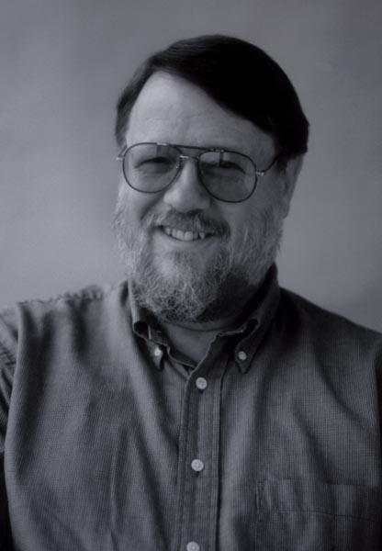
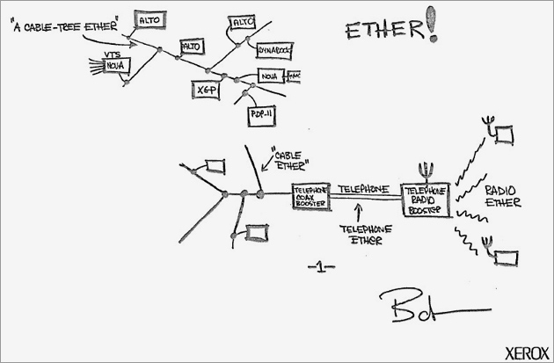
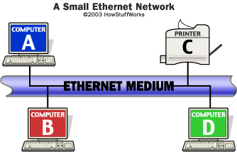
Ethernet
In 1973, while working on a way to link Xerox’s "Alto" computer to a printer, Bob Metcalfe developed the physical method of cabling that connected devices as well as the standards that governed communication on the cable. Called Ethernet, it has since become the most popular and most widely deployed network technology in the world.
software
hardware
Networks
wires
switches
ethernet
Since a signal on the Ethernet medium reaches every attached node, the destination address is critical to identify the intended recipient of the frame.

Slide 19
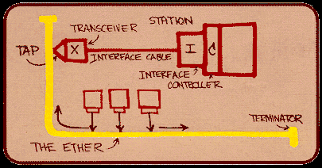
Ethernet
software
hardware
Networks
wires
switches
ethernet
Most of the Ethernet ports in SILS have a speed set to 100mb
In comparison, the wireless ports are set to about 11.7 mb.
The speed on the wireless is limited by the current available technology.

Slide 20
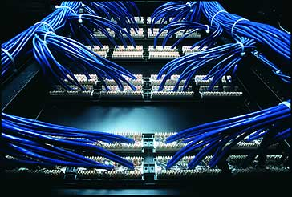
In Manning
The Ethernet connections go to one of several wiring closets in the building
software
Each wiring closet contains Tier 1 switches, to which are connected cat5 utp wires
hardware
Networks
wires
switches
ethernet
Which themselves are connected to the main switch in the main closet
Which itself is the fiber uplink to the Tier 2 switches

Slide 21
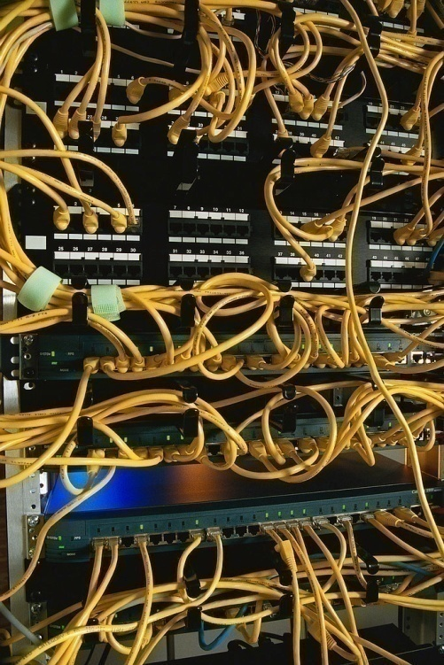
Within Manning
software
Within Manning hall there are 3 networking closets to serve parts of the buildings.
hardware
Networks
wires
switches
ethernet

Slide 22
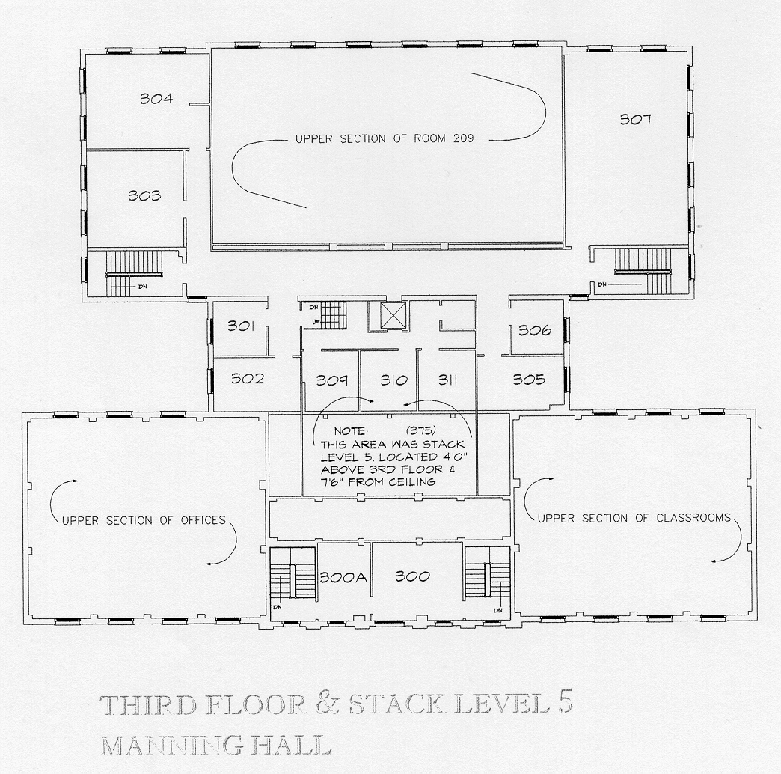
Within Manning
software
The 3rd floor closet is in the 5th level stacks inside the library.
hardware
Networks
wires
switches
ethernet

Slide 23
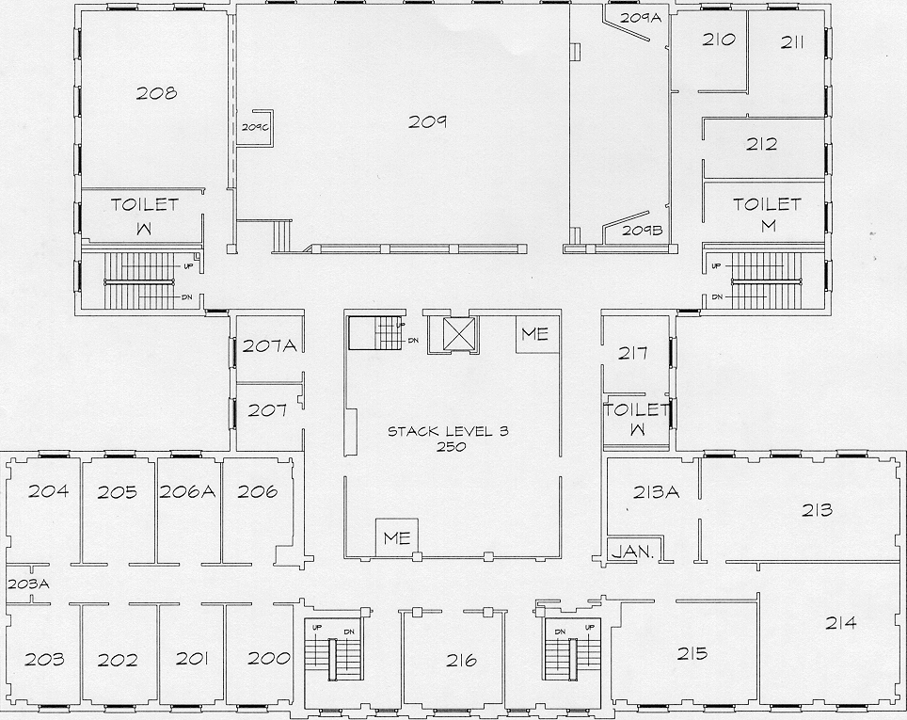
Within Manning
software
The 2nd floor closet is at the end of the hall where the faculty offices are found
hardware
Networks
wires
switches
ethernet

Slide 24
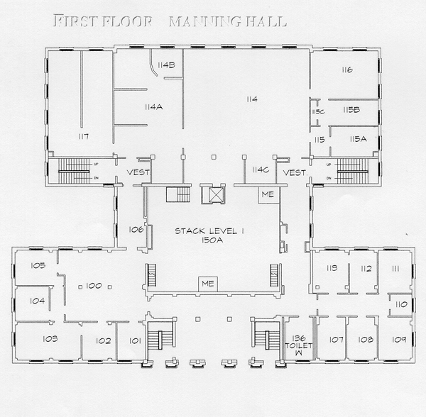
Within Manning
The main closet located off the SILS Computer Lab has the fiber uplink to the campus network going into it.
This is a 1 Gbit uplink
software
hardware
Networks
wires
switches
ethernet

Slide 25
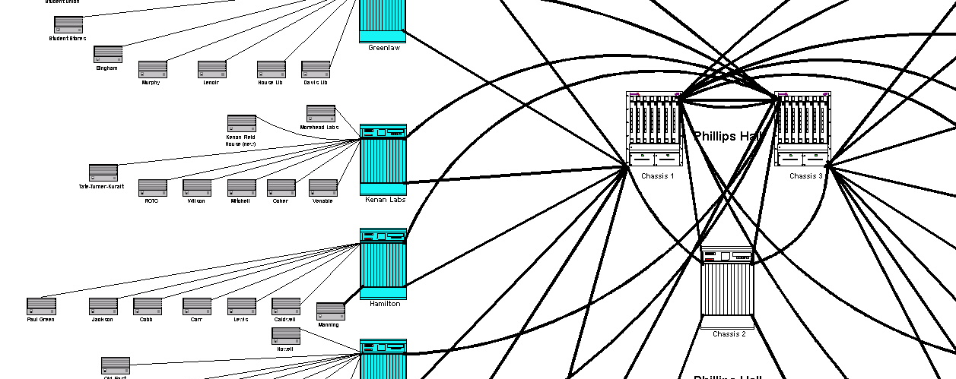
Moving out into the star
software
hardware
Networks
wires
switches
ethernet
Manning Hall
The core switches are then linked out to other Tier 2 Switches that provide links to other buildings near them.
In each building, there are switches to provide ports for each wall port.
For each port on the wall, there is a port somewhere on a switch that it is connected to.
for the most part, there are in fact more wall ports than switch ports, so in some cases not all the ports in a building can be connected at once.

Slide 26
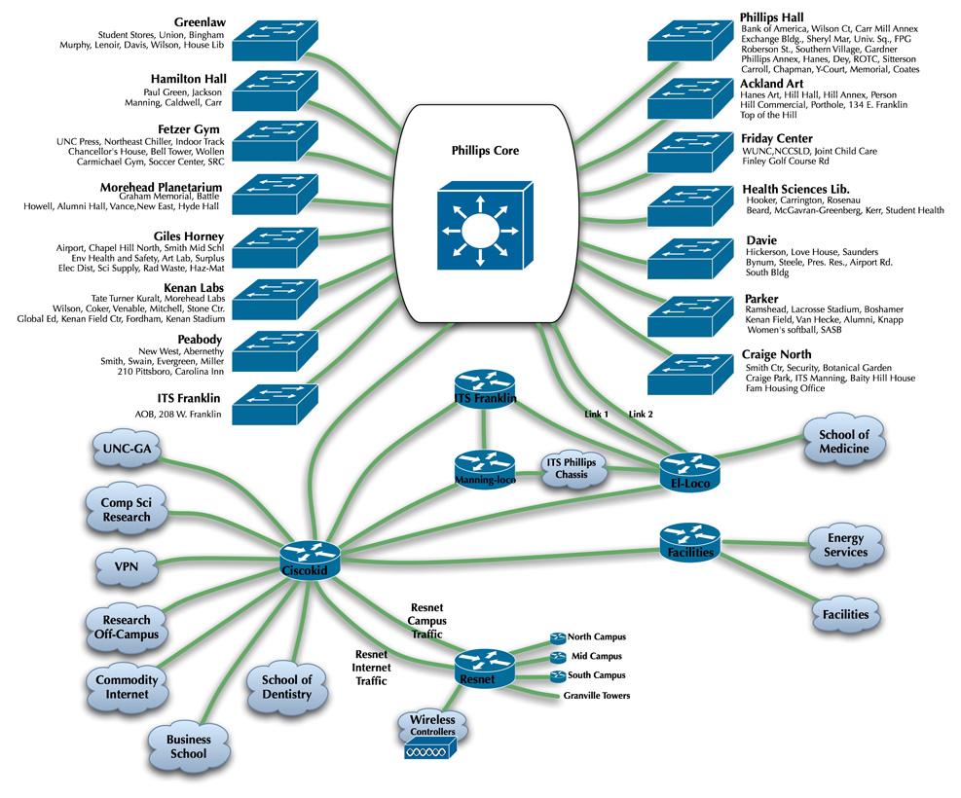
UNC Campus
The campus is laid out in a "star" topology in which central switches are linked in a star fashion.
Different devices can be connected to a switch and a switch can include other switches, computers, wireless access points, or any other network device.
software
hardware
Networks
wires
switches
ethernet

Slide 27
UNC Campus
A main "core" set of three (for redundancy) switches are located in the control center in Phillips
software
hardware
Networks
wires
switches
ethernet

Slide 28
UNC Campus
- Isis uplinks to the commodity internet (the "real" internet) through Cisco Kid to MCNC(our ISP).
- We have a 2.4 Gbit uplink to the internet through this. We share a link with many of the other universities and schools in North Carolina.
- Cisco Kid is our main router that does all the "work" of finding addresses and managing traffic into, and out of our network
software
hardware
Networks
wires
switches
ethernet
Cisco Kid

Slide 29
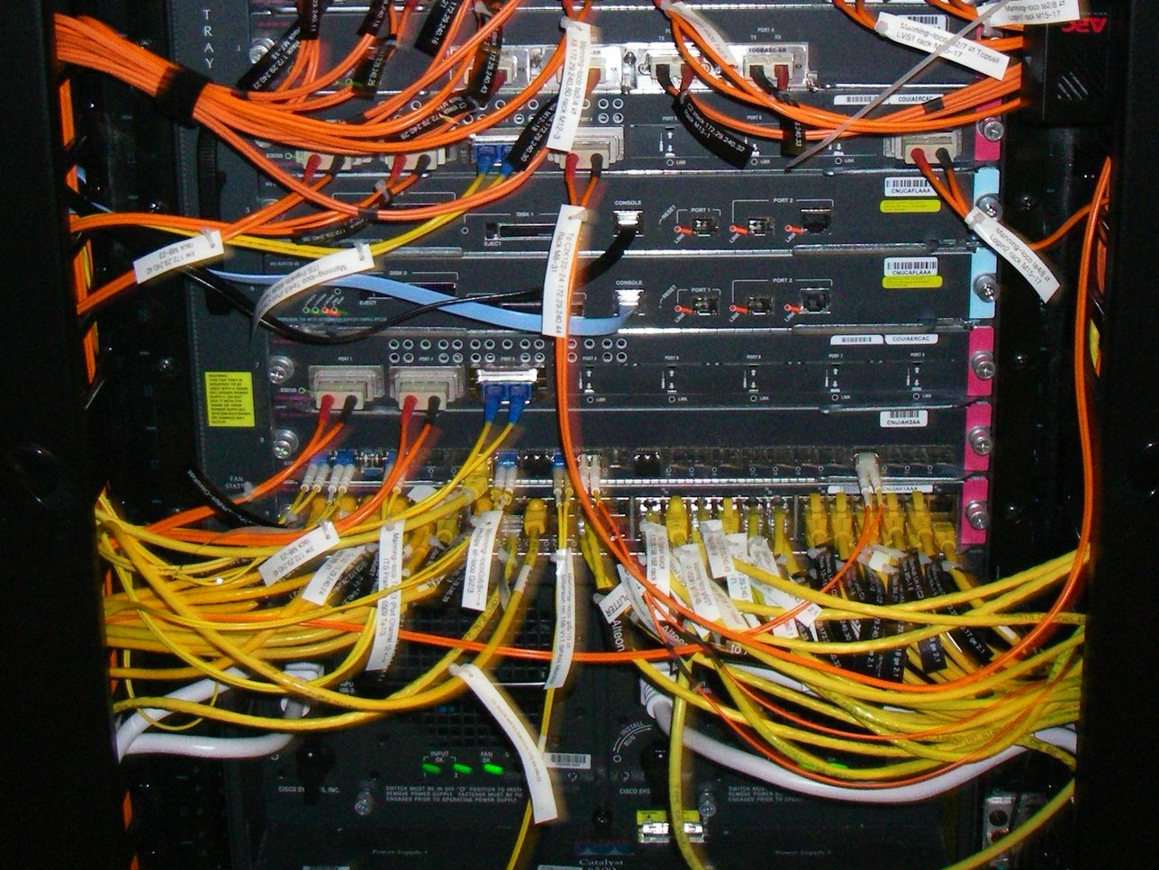
Manning-Loco located in the Data Center in ITS Manning
software
hardware
Networks
wires
switches
ethernet
If you are accessing one of the ITS servers (like www.unc.edu or help.unc.edu) then your traffic flows through this router.

Slide 30
But how does it all tie together?
For the answer, we have to look at some Internet Principles

Slide 31
The TCP/IP Standard Model
Application/process to process FTP, telnet, HTTP, SSH
Transport/host to host TCP
Internetworking
IP
Hardware – wires, hosts, routers
TCP/IP
Inter
networks
hosts
standards
packets
examples

Slide 32
The TCP/IP Standard Model
Application/process to process FTP, telnet, HTTP, SSH
Transport/host to host TCP
Internetworking
IP
Hardware – wires, hosts, routers
TCP/IP
Inter
networks
hosts
standards
packets
examples
What’s a host?

Slide 33
What’s a host?
It’s an Internet connected computer with
an Internet address and (perhaps) a domain name.
An internet address
is a unique, 4-byte integer.
unambiguously identifies a computer (actually a network interface card)
Application/process to process FTP, telnet, HTTP, SSH
Transport/host to host TCP
Internetworking
IP
Hardware – wires, hosts, routers
TCP/IP
Inter
networks
hosts
standards
packets
examples
What’s a host?
it connects to other hosts via the next layer

Slide 34
The TCP/IP Standard Model
Application/process to process FTP, telnet, HTTP, SSH
Transport/host to host TCP
Internetworking
IP
Hardware – wires, hosts, routers
TCP/IP
Inter
networks
hosts
standards
packets
examples
Protocols & standards are key

Slide 35
The Internet Evolved
Started as four machine demonstration - ARPANET (UCLA, UCSB, SRI, Utah)
But to link them into networks …
Protocols, or standards, were needed
Application/process to process FTP, telnet, HTTP, SSH
Transport/host to host TCP
Internetworking
IP
Hardware – wires, hosts, routers
TCP/IP
Inter
networks
hosts
standards
packets
examples
Thus was born TCP/IP, which provided
Interoperability across heterogeneous machines
End-to-end communication
Reliability in the face of data link failures

Slide 36
TCP/IP????
Stands for Transmission Control Protocol/Internet Protocol
Provides reliable, in-order, end-to-end transmission of data
Application/process to process FTP, telnet, HTTP, SSH
Transport/host to host TCP
Internetworking
IP
Hardware – wires, hosts, routers
TCP/IP
Inter
networks
hosts
standards
packets
examples
consider the alternative

Slide 37
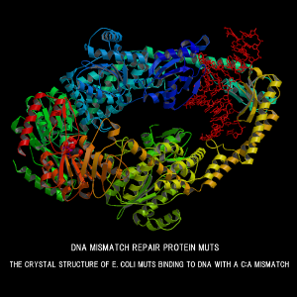
TCP/IP????
Stands for Transmission Control Protocol/Internet Protocol
Provides reliable, in-order, end-to-end transmission of data
TCP/IP
Inter
networks
hosts
standards
packets
examples
consider the alternative

Slide 38
More on Protocols
Think of sending a letter
IP makes sure the envelope is addressed in the same way so that anyone could receive it
TCP is more like sending a certified letter - you get a response that someone has received it.
TCP also makes sure that the parts of the letter are all received and are IN ORDER
Application/process to process FTP, telnet, HTTP, SSH
Transport/host to host TCP
Internetworking
IP
Hardware – wires, hosts, routers
TCP/IP
Inter
networks
hosts
standards
packets
examples
protocols & standards are key

Slide 39
More on Protocols
Service & application layer protocols (i.e. HTTP, FTP) ensure that the sender and receiver are speaking the same language, and that the letter can be interpreted
Application/process to process FTP, telnet, HTTP, SSH
Transport/host to host TCP
Internetworking
IP
Hardware – wires, hosts, routers
TCP/IP
Inter
networks
hosts
standards
packets
examples
protocols & standards are key

Slide 40
What are packets?
In reality, each “letter” is sent in a bunch of pieces - as if you had sent it one page at a time.
These pieces are packets.
Local Area Network
Routers
TCP/IP
Inter
networks
hosts
standards
packets
examples

Slide 41
A possible piece of the Internet
Let’s consider an example
Local Area Network
Could be us
Routers
TCP/IP
Inter
networks
hosts
standards
packets
examples

Slide 42
A possible piece of the Internet
For us to get train tickets from “Die Bahn”, we have to send it a message
The Internet
Local Area Network
Could be us
Routers
TCP/IP
Inter
networks
hosts
standards
packets
“Ruby”
152.2.81.1
examples
They are there
Cisco Kid
“www.bahn.de”
81.200.192.68

Slide 43
A packet example
Suppose Harry wants to talk to Sally
The Internet
Harry.com
Routers
TCP/IP
Inter
networks
hosts
standards
packets
Sally.edu
examples

Slide 44
A packet example
Suppose Harry wants to talk to Sally. Harry creates a message on his client
The Internet
Hi, Sally, what’s up?
Routers
TCP/IP
Inter
networks
hosts
standards
packets
Sally.edu
examples

Slide 45
A packet example
His client breaks it up into small TCP packets for transmission
The Internet
Hi, S
all
y, W
hat
s’ up?
Routers
TCP/IP
Inter
networks
hosts
standards
packets
Sally.edu
examples

Slide 46
A packet example
And sends it on its way
The Internet
Harry.com
Routers
but it doesn’t have to go in a single order or along a single path
TCP/IP
Inter
networks
hosts
standards
s’ up?
packets
Sally.edu
examples
all
hat
y, W
Each router reads the address and rejects it if the address isn’t on its network
Hi, S

Slide 47
A packet example
Overly simplified, IP gets it to the right place, TCP puts the pieces back together in order
The Internet
Harry.com
Routers
And so it gets to its destination
TCP/IP
Inter
networks
hosts
standards
s’ up?
packets
Sally.edu
examples
Hi, Sally, what’s up?
all
hat
y, W
Hi, S

Slide 48
The TCP/IP Standard Model
Or run - Application/process to process FTP, telnet, HTTP, SSH
Transport/host to host TCP – to provide
Internetworking
IP – to provide
Hardware – wires, hosts, routers - use
TCP/IP
Inter
networks
hosts
standards
packets
examples
protocols & standards are key

Slide 49
The TCP/IP Standard Model
Servers can be physical computers; Servers can also be software applications
One server (physical computer) can run many servers (software applications) at a time
So, how does the host application know when the data being received is for it?
Or run - Application/process to process FTP, telnet, HTTP, SSH
Transport/host to host TCP – to provide
Internetworking
IP – to provide
Hardware – wires, hosts, routers - use
TCP/IP
Inter
networks
hosts
standards
packets
examples
protocols & standards are key

Slide 50
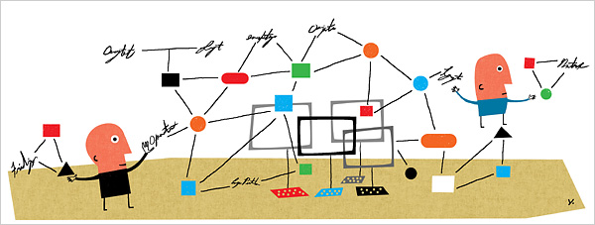
It uses standards
Or run - Application/process to process FTP, telnet, HTTP, SSH
Transport/host to host TCP – to provide
Internetworking
IP – to provide
Hardware – wires, hosts, routers - use
TCP/IP
Inter
networks
hosts
standards
packets
examples
protocols & standards are key

Slide 51
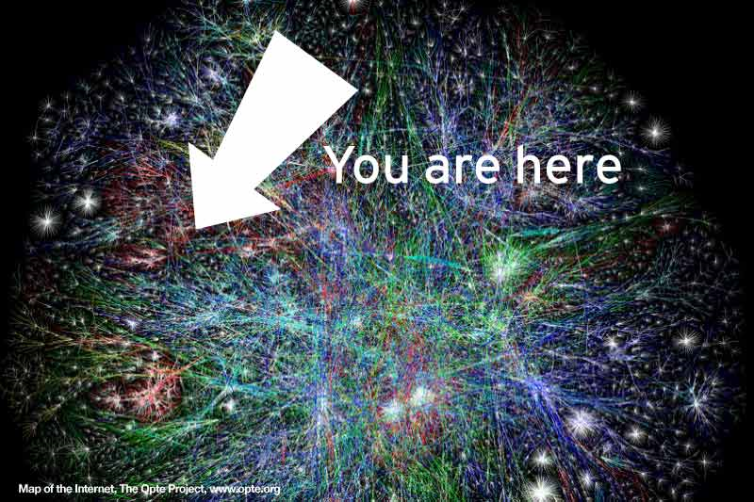
Next
More about the Internet

